Slide 1
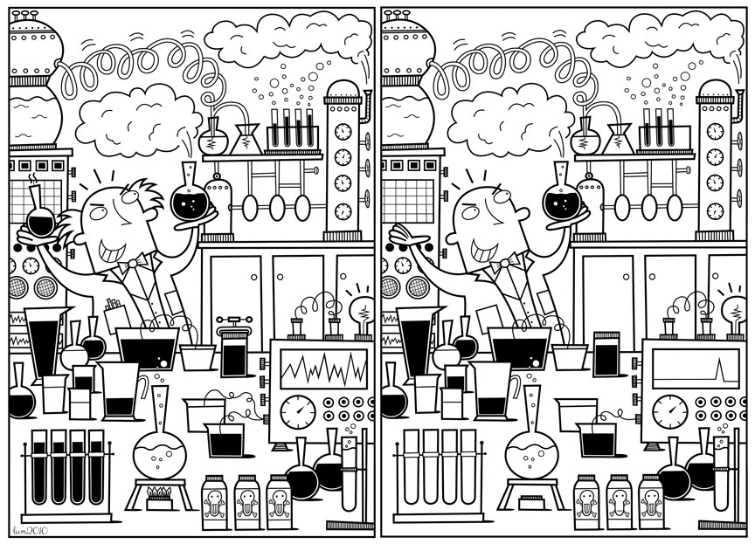
One of These Things Is not Like the Other: Factorial Invariance in Structural Equation Modeling
Nathan Lutz
STAT 488
9/27/21

Slide 2
Outline
Brief introduction to Structural Equation Modeling
Factorial Invariance
My Dataset
Applied Example in R
Questions

Slide 3
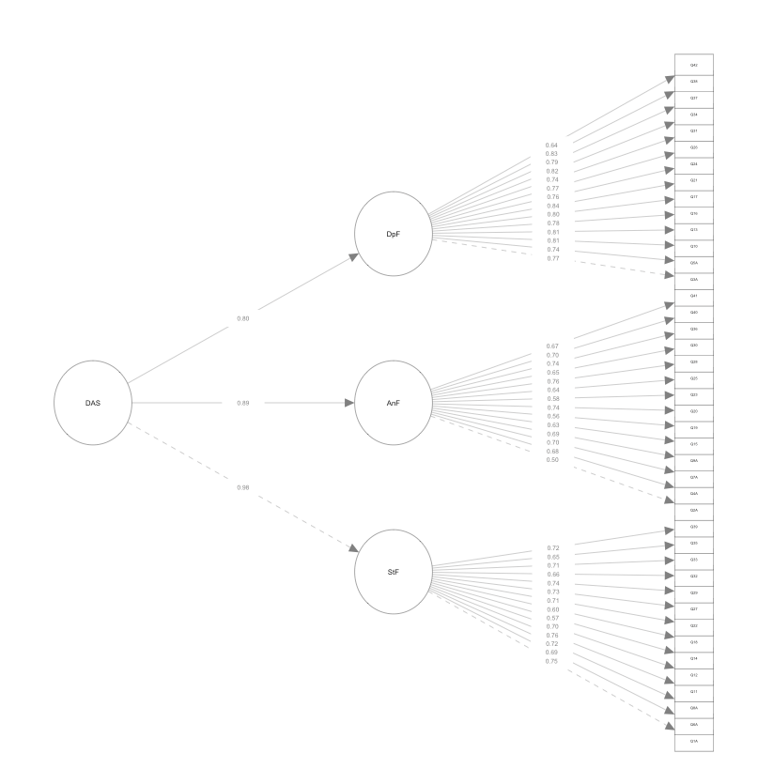
Background
Structural Equation Modeling
First developed in the 1930s, but took off in the 1970s and 1980s
Goal is to measure latent variables
Especially important in the social sciences

Slide 4
Factorial Invariance
Undergradute Students
Most Structural Equation Models assume models apply to everyone across all contexts
i.e., they are “invariant”
What do we do when this isn’t true?
Graduate Students

Slide 5
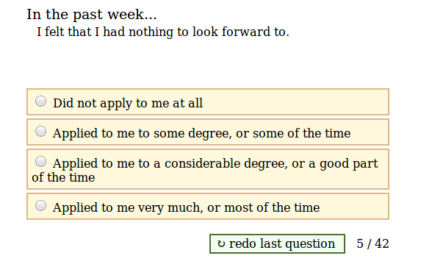
My Dataset-the DASS
Depression Anxiety and Stress Scale (DASS)
Retrieved from:
openpsychometrics.org
39,149 participants
42 items
14 in each subscale
Each item on a scale of 1-4
Presented in random order

Slide 6
My Dataset
DASS Scores differ across males and females
Total DASS Scores t(14,458) = 20.72, p < .001
Depression t(13,976) = 6.02, p < .001
Anxiety t(14,790) = 27.83, p < .001
Stress t(14,130) = 24.97, p < .001
Simple sum scores treat all items as equally important AND the same for males and females

Slide 7
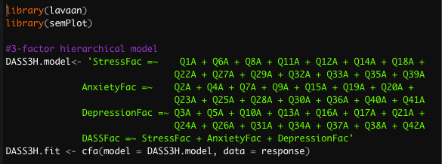
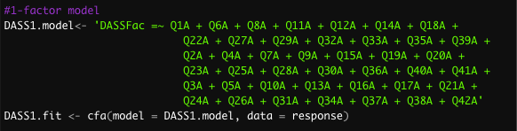
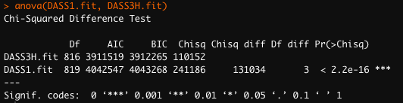
SEM in R
Goes beyond sum scores
Creates latent factors with different loadings for each item
Can be done using the lavaan package in R
Can easily create and compare competing models

Slide 8
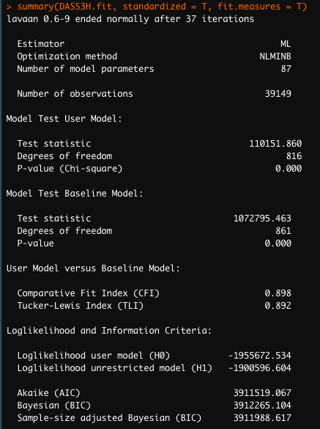
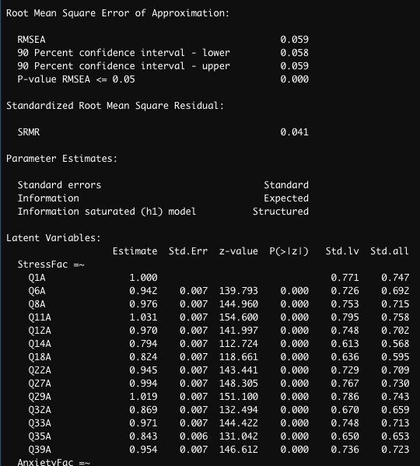
SEM in R
After determining optimal model, can evaluate specifics
Fit statistics
RMSEA < .08 or < .05
SRMR < .08
CFI > .90
Factor loadings for all 42 items

Slide 9
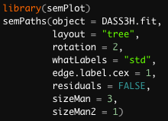
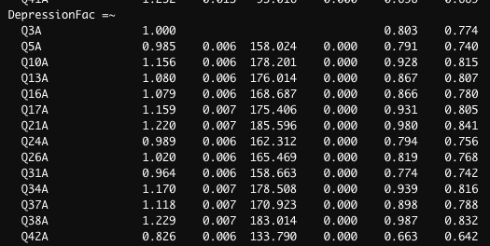
SEM in R
semPlot helps make interpretation easier

Slide 10
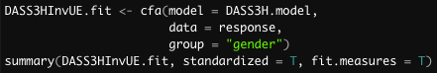



Factorial Invariance
$$≠$$
Adding another layer
Bringing gender in
Original Model
$$=$$
Two-group “variant” model
Two-group “invariant” model

Slide 11
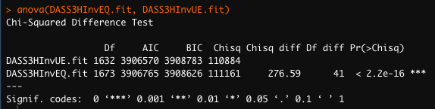
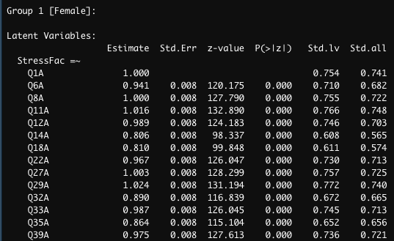
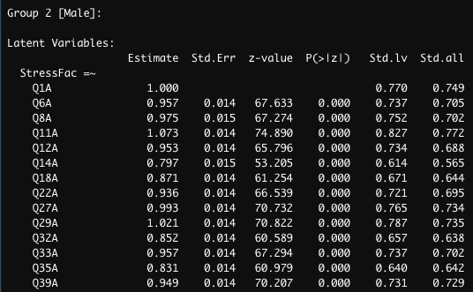
Factorial Invariance
Adding another layer
Bringing gender in
Original Model
Two-group “variant” model
Two-group “invariant” model

Slide 12
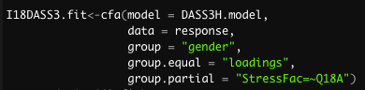
A Touchy Subject
Item 18 loads differently for males and females

Slide 13
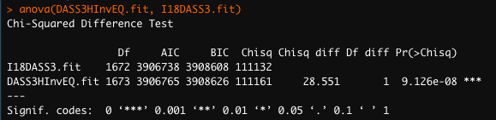
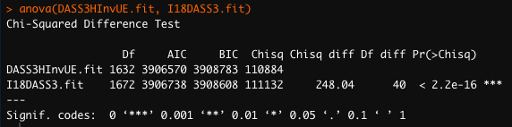
A Touchy Subject
Item 18 loads differently for males and females

Slide 14
Closing Thoughts
Sex/Gender is only one example
Fixing factor loadings is only one option
Extensions beyond psychometrics
SEM is a powerful way of showing group differences!

Slide 15
Questions?

